Slide 1
Customer Churn Prediction IN TELECOM INDUSTRY
-PRESENTED BY ANANYA CHAKRABORTY & SHIVANI SHARMA

Slide 2
SYNOPSIS
BUSINESS PROBLEM
TOOLS USED
PROCESS FLOW
EXPLOLATORY DATA ANALYSIS
FEATURE SELECTION
DATA PREPROCESSING FOR CHURN MODELLING
CHURN PREDICTION
FUTURE SCOPE

Slide 3
BUSINESS PROBLEM
Customer churn which is also known as customer attrition, is primarily the loss of clients or customers by a company.
Companies which provide subscription based services like telecom, internet service providers, cable TV providers often use customer attrition analysis and customer attrition rates as one of their key business parameters to retain the customers. This is because the cost of retaining an existing customer is comparatively lesser as compared to acquiring a new one.
With time, customer loyalty has become an issue and the companies who provide subscription based services are at a higher risk of incurring losses due to customer attrition. Hence, it has become important for companies to identify the major factors that lead to termination of services and thus taking necessary measures to retain the customers.

Slide 4
TOOLS USED
NUMPY FOR NUMERICAL CALCULATION
PANDAS FOR DATA MANIPULATION
MATPLOTLIB & SEABORN FOR DATA VISUALIZATION
SKLEARN FOR APPLYING ML ALGORITHMS
JUPYTER NOTEBOOK AS AN IDE TO RUN THE PROJECT

Slide 5
Objectives of the Project
To predict the Customer Churn almost accurately
Identifying the main features that lead to customer attrition
Use the relevant Machine Learning algorithms to develop prediction based models, evaluate the accuracy of the model and check the overall performance of the model.
Ultimately picking out the best model that is useful for our business and deploying it to reduce the customer churn.

Slide 6
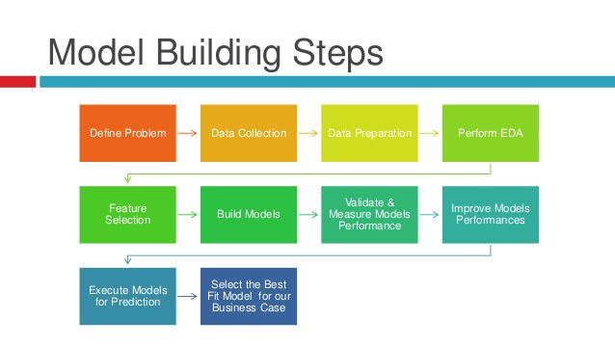

Slide 7
DESCRIBE THE DATA
Our Telco data has 3333 records and 21 variables
Total 20 records are input variables and 1 record is output variable
Since our machine learning algorithm uses only numeric data as input value, we have to convert few data records to numerical value usine label encoding
Our data doesn’t have any missing value and is clean. We use isnull() to check the missing values.

Slide 8
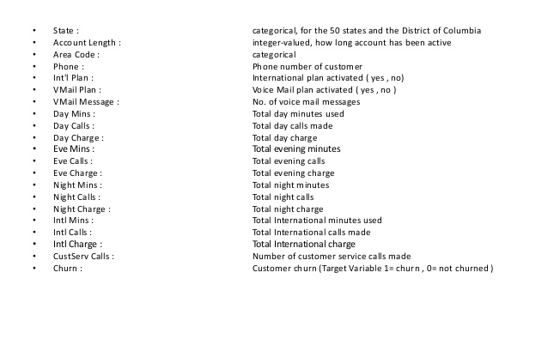
VARIABLE DESCRIPTION

Slide 9
OBSERVATIONS FROM EXPLORATORY DATA ANALYSIS
Customers who contact the customer support in greater volume are likely to churn more as compared to those who don’t contact the customer support
Customers who have Voice Mail Plan churn lesser as compared to other plans
Customers with International Plan also churn frequently

Slide 10
FEATURE SELECTION
Features that were identified during the model building process:
Features like Vmail_Plan, Intl_Plan and State do affect the overall prediction of the model hence, feature scaling was performed to make them adaptable for machine learning model predictions
Variables like Area Code and Phone were dropped from the dataset as they didn’t affect the Churn prediction hence they were rendered useless
New variable known as 'Avg_Night_Calls‘ was added to help improve model performance

Slide 11
Classification.
Classification. The goal of classification is to determine to which class or category a data point (customer in our case) belongs to. For classification problems, data scientists would use historical data with predefined target variables AKA labels (churner/non-churner) – answers that need to be predicted – to train an algorithm. With classification, businesses can answer the following questions:
Will this customer churn or not?
Will a customer renew their subscription?
Will a user downgrade a pricing plan?
Are there any signs of unusual customer behavior?
The fourth question about atypical behavior signs represents a type of a classification problem called anomaly detection. Anomaly detection is about identifying outliers – data points that significantly deviate from the rest of the data.

Slide 12
Regression
Customer churn prediction can be done by performing a regression task.
Regression analysis is primarily a statistical technique which is used to estimate the relationship between a target variable and existing data values that influence the target variable, expressed in continuous values.
If that’s too hard – the result of regression is always some number, while classification always suggests a category.
In addition, regression analysis allows for estimating how many different variables in data influence a target variable. With regression, businesses can forecast in what period of time a specific customer is likely to churn or receive some probability estimate of churn per customer.

Slide 13
MODELING AND TESTING
The main goal of this project stage is to develop a churn prediction model. Specialists usually train numerous models, tune, evaluate, and test them to define the one that detects potential churners with the desired level of accuracy on training data.

Slide 14
LOGISTIC REGRESSION
Logistic regression is an algorithm used for binary classification problems. It predicts the likelihood of an event by measuring the relationship between a dependent variable and one or more independent variables (features). More specifically, logistic regression will predict the possibility of an instance (data point) belonging to the default category.

Slide 15
DECISION TREE CLASSIFIER
A decision tree is a type of supervised learning algorithm (with a predefined target variable.) While mostly used in classification tasks, it can handle numeric data as well. This algorithm splits a data sample into two or more homogeneous sets based on the most significant differentiator in input variables to make a prediction. With each split, a part of a tree is being generated. As a result, a tree with decision nodes and leaf nodes (which are decisions or classifications) is developed. A tree starts from a root node – the best predictor.

Slide 16
RANDOM FOREST CLASSIFIER
A Random forest is a type of an ensemble learning method that uses numerous decision trees to achieve higher prediction accuracy and model stability. This method deals with both regression and classification tasks. Every tree classifies a data instance (or votes for its class) based on attributes, and the forest chooses the classification that received the most votes. In the case of regression tasks, the average of different trees’ decisions is taken.

Slide 17
Best Model for Churn Prediction
Random Forest is better at fitting non-linear data. It can also work well even if there are correlated features, which can be a problem for interpreting logistic regression
Random forest reduces the variance issue in Decision Tree by averaging many trees, thus giving more accurate results
We will implement, ROC & AUC score to check the precison and recall score and thus implement the F1_score
F1_score= 2* (Precision * Recall)/(Precision +Recall)

Slide 18
Why is Churn Rate Important in Customer Analytics?
Churn rate is a health indicator for subscription-based companies. The ability to identify customers that aren’t happy with provided solutions allows businesses to learn about product or pricing plan weak points, operation issues, as well as customer preferences and expectations to proactively reduce reasons for churn.

Slide 19
CHURN RATE PREDICTION WITH MACHINE LEARNING
Existing Customer
Churned Customer History
Churn Prediction Model
Customers at risk of Churn
Pattern Recognition
Happy Customers
Proactive Re-Engagement

Slide 20
LIMITATIONs & FUTURE SCOPE
We haven’t performed Model Tuning at the moment.
Model Tuning: We know that machine learning algorithms are driven by parameters. These parameters majorly influence the outcome of learning process.
The objective of parameter tuning is to find the optimum value for each parameter to improve the accuracy of the model.
Ensemble methods: This technique simply combines the result of multiple weak models and produce better results. This can be achieved through bagging and boosting

